Slide 1
Making Capital Investment Decisions
10
Prepared by Anne Inglis, Ryerson University
Notes:
9.<number>

Slide 2
Financial Management for Engineers Week 8: Summer 2019
Capital budgeting and capital investment decisions
10-<number>

Slide 3
Key Concepts and Skills
Understand how to determine the relevant cash flows for a proposed project
Know how to project the cash flows and determine if a project is acceptable
Understand the various methods for computing operating cash flow
Be able to compute the CCA tax shield
Know how to evaluate cost-cutting proposals
Be able to analyze replacement decisions
Understand how to evaluate the equivalent annual cost of a project
Know how to set a bid price for a project
10-<number>
Notes:
9.<number>

Slide 4
Relevant Cash Flows 10.1
LO1
The cash flows that should be included in a capital budgeting analysis are those that will only occur (or not occur) if the project is accepted
These cash flows are called incremental cash flows
The stand-alone principle allows us to analyze each project in isolation from the firm simply, by focusing on incremental cash flows
10-<number>
Notes:
9.<number>

Slide 5
Asking the Right Question
LO1
You should always ask yourself “Will this cash flow occur (or not occur) ONLY if we accept the project?”
  If the answer is “yes”, it should be included in the analysis because it is incremental
  If the answer is “no”, it should not be included in the analysis because it will occur anyway
  If the answer is “part of it”, then we should include the part that occurs (or does not occur) because of the project
10-<number>
Notes:
9.<number>

Slide 6
Common Types of Cash Flows 10.2
LO1
Sunk costs – costs that have been incurred in the past
Opportunity costs – costs of lost options
Side effects
  Positive side effects – benefits to other projects
  Negative side effects – costs to other projects
Changes in net working capital
Financing costs
Inflation
Government Intervention
Capital Cost Allowance (CCA)
10-<number>
Notes:
9.<number>
With each of these types of cash flows, you should ask the class the question on the previous slide so that they can start to determine if the cash flows are relevant.
Sunk costs – If you hired lawyers to file patents on a new R&D concept six months ago, should you consider their fees in your project? The answer is “no” because you have to fulfill your contractual obligations and pay your lawyers whether you go ahead with the project or not. These costs are therefore not relevant to your capital budgeting analysis.
Opportunity costs – the classic example of an opportunity cost is the use of land or plant that is already owned. It is important to point out that this is not “free.” At the very least we could sell the land; consequently if we choose to use it, we cost ourselves the selling price of the asset.
A good example of a positive side effect is when you will establish a new distribution system with this project that can be used for existing or future projects. The benefit provided to those projects needs to be considered.
The most common negative side effect is erosion or cannibalism, where the introduction of a new product will reduce the sales of existing, similar products. A good real-world example is what happens to corn flakes sales when Kellogg’s introduces a new breakfast cereal.
It is important to consider changes in NWC. We need to remember that operating cash flow derived from the income statement assumes all sales are cash sales and that the COGS was actually paid in cash during that period. By looking at changes in NWC specifically, we can adjust for the difference in cash flow that results from accounting conventions. Most projects will require an increase in NWC initially as we build inventory and receivables.
We do not include financing costs. Students often have difficulty understanding why when it appears that we will only raise capital if we take the project. It is important to point out that because of economies of scale, companies generally do not finance individual projects. Instead, they finance the entire portfolio of projects at one time. The other reason has to do with maintaining a target capital structure over time, but not necessarily each year.
Taxes will change as the firm’s taxable income changes. Consequently, we have to consider cash flows on an after-tax basis.

Slide 7
Pro Forma Statements and Cash Flow 10.3
LO2
Capital budgeting relies heavily on pro forma accounting statements, particularly income statements
Computing cash flows – refresher
  Operating Cash Flow (OCF) = EBIT + depreciation – taxes
  Cash Flow From Assets (CFFA) = OCF – net capital spending (NCS) – changes in NWC
10-<number>
Notes:
9.<number>
Operating cash flow – students often have to go back to the income statement to see that the two definitions of operating cash flow are equivalent when there is no interest expense.

Slide 8
Example: Pro Forma Income Statement
LO2
Sales (50,000 units at $4.00/unit) | $200,000
Variable Costs ($2.50/unit) | 125,000
Gross profit | $ 75,000
Fixed costs | 12,000
Depreciation ($90,000 / 3) | 30,000
EBIT | $ 33,000
Taxes (34%) | 11,220
Net Income | $ 21,780
10-<number>
Notes:
9.<number>

Slide 9
Example: Projected Capital Requirements
LO2
 | Year
 | 0 | 1 | 2 | 3
NWC | $20,000 | $20,000 | $20,000 | $20,000
Net Fixed Assets | 90,000 | 60,000 | 30,000 | 0
Total Investment | $110,000 | $80,000 | $50,000 | $20,000
10-<number>
Notes:
9.<number>
Ask the students why net fixed assets is decreasing each year. It is important that they understand that when they go to compute the net capital spending in the next slide.

Slide 10
Example: Projected Total Cash Flows
LO2
 | Year
 | 0 | 1 | 2 | 3
OCF |  | $51,780 | $51,780 | $51,780
Change in NWC | -$20,000 |  |  | 20,000
Capital Spending | -$90,000
CFFA | -$110,000 | $51,780 | $51,780 | $71,780
10-<number>
Notes:
9.<number>
OCF = EBIT + depreciation – taxes = 33,000 + 30,000 – 11,220 = 51,780; or
OCF = NI + depreciation = 21,780 + 30,000 = 51,780
Note that in the Table in the book, the negative signs have already been carried throughout the table so that the columns can just be added. Ultimately, students seem to do better with this format even though the CFFA equation says to subtract the changes in NWC and net capital spending.
Change in NWC = We have a net investment in NWC in year 0 of 20,000; we get the investment back at the end of the project when we sell our inventory, collect on our receivables and pay off our payables. Students often forget that we get the investment back at the end.
Capital Spending – remember that Net capital spending = change in net fixed assets + depreciation. So in year one NCS = (60,000 – 90,000) + 30,000 = 0; The same is true for the other years.

Slide 11
Making The Decision
LO2
Assume the required return is 20%
Enter the cash flows into the calculator and compute NPV and IRR
  CF₀ = -110,000; C01 = 51,780; F01 = 2; C02 = 71,780
  NPV; I = 20; CPT NPV = 10,648
  CPT IRR = 25.8%
Should we accept or reject the project?
10-<number>
Notes:
9.<number>
You can also use the formulas to compute NPV and IRR, just remember that the IRR computation is trial and error.

Slide 12
More on NWC 10.4
LO1
Why do we have to consider changes in NWC separately?
  GAAP requires that sales be recorded on the income statement when made, not when cash is received
  GAAP also requires that we record cost of goods sold when the corresponding sales are made, regardless of whether we have actually paid our suppliers yet
  Finally, we have to buy inventory to support sales although we haven’t collected cash yet
10-<number>
Notes:
9.<number>
The first two items mean that our operating cash flow does not include the impact of accounts receivable and accounts payable on cash flow. The third item is very much like the purchase of fixed assets. We have to buy the assets (have the cash flow) before we can generate sales.
By looking at changes in NWC, we can incorporate the increased investment in receivables and inventory that are necessary to support additional sales. Because we look at changes in NWC, and not just current assets, we also incorporate the increase in our payable accounts that partially pays for the investment in inventory and receivables.

Slide 13
Capital Cost Allowance (CCA)
LO4
CCA is depreciation for tax purposes
The depreciation expense used for capital budgeting should be calculated according to the CCA schedule dictated by the tax code
Depreciation itself is a non-cash expense, consequently, it is only relevant because it affects taxes
Depreciation tax shield = DT
  D = depreciation expense
  T = marginal tax rate
10-<number>
Notes:
9.<number>

Slide 14
Computing Depreciation
LO4
Need to know which asset class is appropriate for tax purposes
Straight-line depreciation
  D = (Initial cost – salvage) / number of years
  Very few assets are depreciated straight-line for tax purposes
Declining Balance
  Multiply percentage given in CCA table by the un-depreciated capital cost (UCC)
  Half-year rule
  Can use PV of CCA Tax Shield Formula:
10-<number>
Notes:
9.<number>

Slide 15
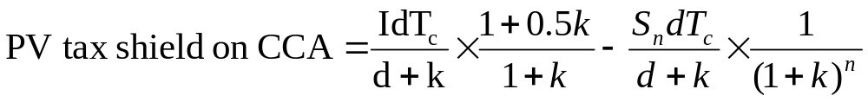
PV of CCA Tax Shield Formula
LO4
Where:
  I = Total Capital Investment
  d = CCA tax rate
  Tc = Corporate Tax Rate
  k = discount rate
  S_{n} = Salvage value in year n
  n = number of periods in the project
10-<number>
Notes:
9.<number>

Slide 16
Example: Depreciation and Salvage
LO4
You purchase equipment for $100,000 and it costs $10,000 to have it delivered and installed. Based on past information, you believe that you can sell the equipment for $17,000 when you are done with it in 6 years. The company’s marginal tax rate is 40%. If the applicable CCA rate is 20% and the required return on this project is 10%, what is the present value of the CCA tax shield?
10-<number>
Notes:
9.<number>

Slide 17
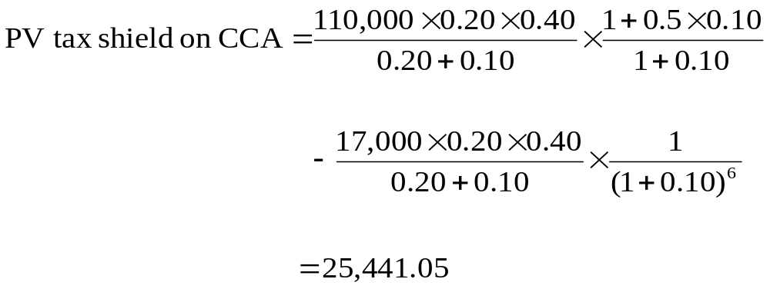
Example: Depreciation and Salvage continued
LO4
The delivery and installation costs are capitalized in the cost of the equipment
10-<number>
Notes:
9.<number>

Slide 18
Other Methods for Computing OCF 10.5
LO3
Bottom-Up Approach
  Works only when there is no interest expense
  OCF = NI + depreciation
Top-Down Approach
  OCF = Sales – Costs – Taxes
  Don’t subtract non-cash deductions
Tax Shield Approach
  OCF = (Sales – Costs)(1 – T) + Depreciation*T
10-<number>
Notes:
9.<number>

Slide 19

Salvage Value versus UCC 10.6
LO4
Using the methods described in the previous slide will give incorrect answers when the salvage value differs from its UCC
If the asset is depreciated using a declining balance method, then the CCA tax shield formula is the most accurate approach, since it takes into account the future CCA impact
10-<number>
Notes:
9.<number>

Slide 20
Example: Replacement Problem
LO6
Original Machine
  Initial cost = 100,000
  CCA rate = 20%
  Purchased 5 years ago
  Salvage today = 65,000
  Salvage in 5 years = 10,000
New Machine
  Initial cost = 150,000
  5-year life
  Salvage in 5 years = 0
  Cost savings = 50,000 per year
  CCA rate = 20%
Required return = 10%
Tax rate = 40%
10-<number>
Notes:
9.<number>

Slide 21
Example: Replacement Problem continued
LO6
Remember that we are interested in incremental cash flows
If we buy the new machine, then we will sell the old machine
What are the cash flow consequences of selling the old machine today instead of in 5 years?
10-<number>
Notes:
9.<number>
If you sell the old machine today, you will receive cash for the equipment today. Additionally, you will NOT receive the salvage value in the future. Finally, your CCA tax shield will be reduced because of the reduction in UCC.

Slide 22
Example: Replacement Problem continued
LO6
If we sell the old equipment today, then we will receive $65,000 today. However, we will also NOT receive $10,000 in 5 years
The appropriate number to use in the NPV analysis is the net salvage value
Always consider after-tax cash flows
You can use your calculator for the cash flows and salvage, but there are no short cuts for finding the PV of the CCA tax shield
10-<number>
Notes:
9.<number>

Slide 23
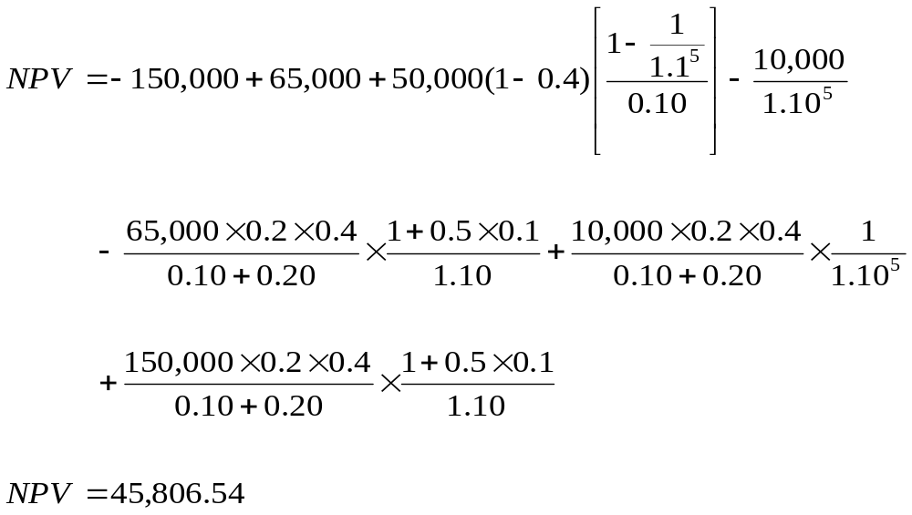
Example: Replacement Problem continued
LO6
Net present value of the project is:
Therefore, the old equipment should be replaced.
10-<number>
Notes:
9.<number>
The year 5 cash flow is the most difficult for students to grasp. It is important to point out that we are looking for ALL changes in cash flow associated with selling the machine today instead of in 5 years. If we do not sell the machine today, then we will have after-tax salvage of 10,000 in 5 years. Since we do sell the machine today, we LOSE the 10,000 cash flow in 5 years.

Slide 24

Example: Equivalent Annual Cost Analysis
LO7
Machine A
  Initial Cost = $150,000
  Pre-tax operating cost = $65,000
  Expected life is 8 years
Machine B
  Initial Cost = $100,000
  Pre-tax operating cost = $57,500
  Expected life is 6 years
The machine chosen will be replaced indefinitely and neither machine will have a differential impact on revenue. No change in NWC is required.
The required return is 10%, the applicable CCA rate is 20% and the tax rate is 40%.
Which machine should you buy?
10-<number>
Notes:
9.<number>
You should buy the machine with the lowest equivalent annual cost. You should buy machine B.

